Slide 1
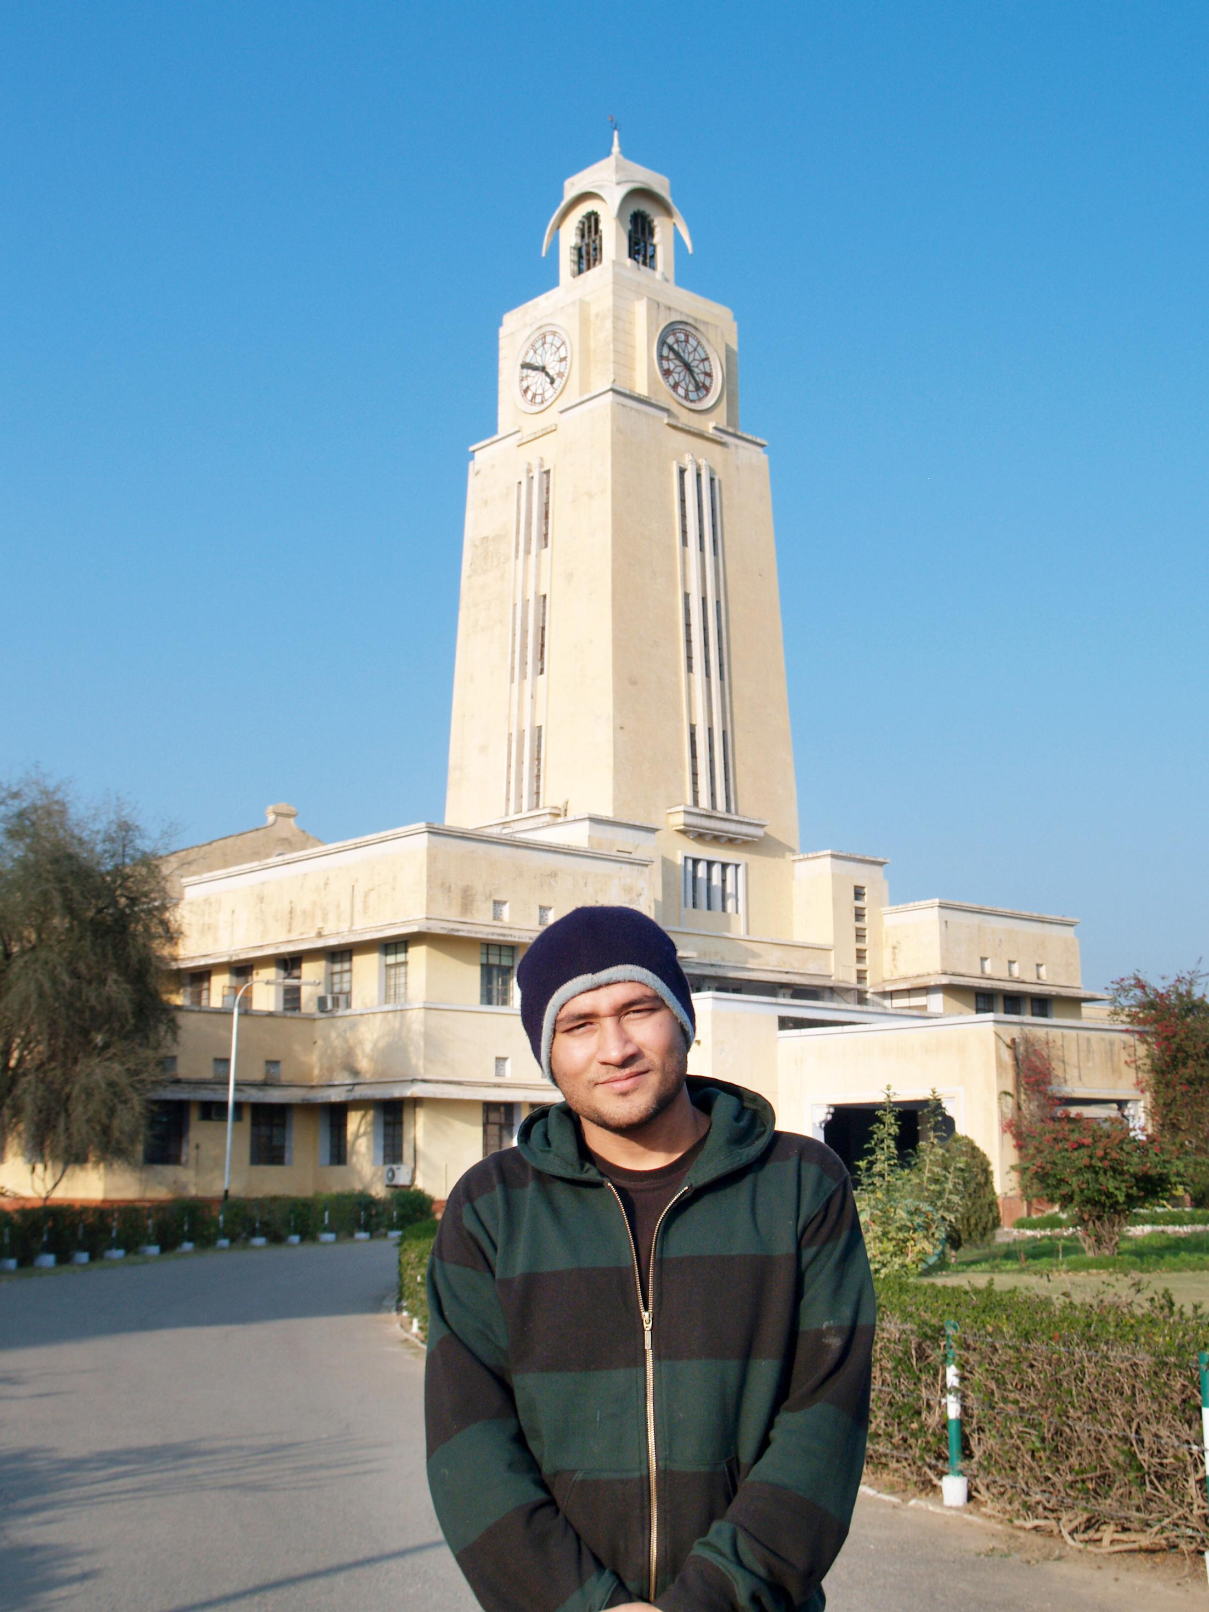
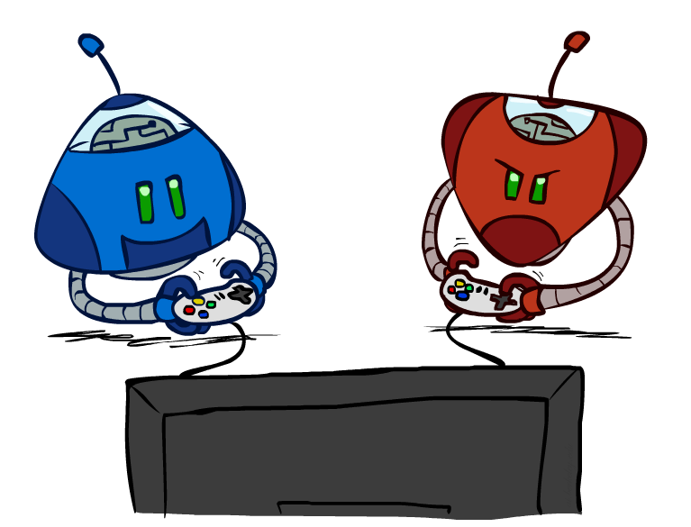


BITS Pilani
Pilani Campus
(some slides adapted from Dan Klein and Pieter Abbeel http://aima.cs.berkeley.edu/)
DSE CL 557 - Artificial and Computational Intelligence
#7. Searching to play games
Sunday, October 11, 2020
Dr. Saikishor Jangiti

Slide 2
Today
Searching to play games
Minimax Algorithm
Alpha-Beta Pruning
Making imperfect real time decisions
Reference: Chapter 5.1 to 5.4 from AI: A modern approach (Russell, Norvig)

Slide 3
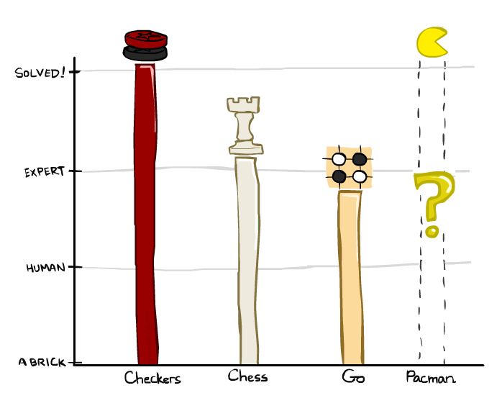
Game Playing State-of-the-Art
Checkers: 1950: First computer player. 1994: First computer champion: Chinook ended 40-year-reign of human champion Marion Tinsley using complete 8-piece endgame. 2007: Checkers solved!
Chess: 1997: Deep Blue defeats human champion Gary Kasparov in a six-game match. Deep Blue examined 200M positions per second, used very sophisticated evaluation and undisclosed methods for extending some lines of search up to 40 ply. Current programs are even better, if less historic.
Go: Human champions are now starting to be challenged by machines. In go, b > 300! Classic programs use pattern knowledge bases, but big recent advances use Monte Carlo (randomized) expansion methods.

Slide 4
Game Playing State-of-the-Art
Checkers: 1950: First computer player. 1994: First computer champion: Chinook ended 40-year-reign of human champion Marion Tinsley using complete 8-piece endgame. 2007: Checkers solved!
Chess: 1997: Deep Blue defeats human champion Gary Kasparov in a six-game match. Deep Blue examined 200M positions per second, used very sophisticated evaluation and undisclosed methods for extending some lines of search up to 40 ply. Current programs are even better, if less historic.
Go: 2016: Alpha GO defeats human champion. Uses Monte Carlo Tree Search, learned evaluation function.
Pacman

Slide 5

Video of Demo Mystery Pacman

Slide 6
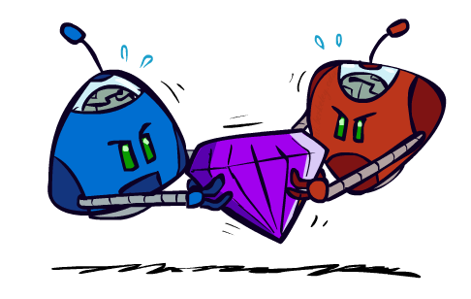
Adversarial Games

Slide 7
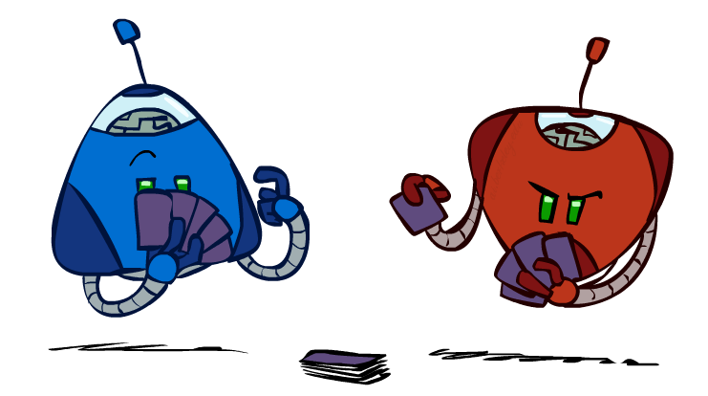
Types of Games
Many different kinds of games!
Axes:
Deterministic or stochastic?
One, two, or more players?
Zero sum?
Perfect information (can you see the state)?
Want algorithms for calculating a strategy (policy) which recommends a move from each state

Slide 8
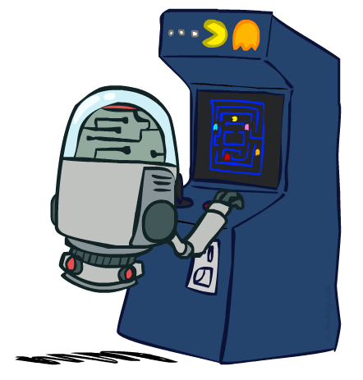
Deterministic Games
Many possible formalizations, one is:
States: S (start at s₀)
Players: P={1...N} (usually take turns)
Actions: A (may depend on player / state)
Transition Function: SxA → S
Terminal Test: S → {t,f}
Terminal Utilities: SxP → R
Solution for a player is a policy: S → A

Slide 9
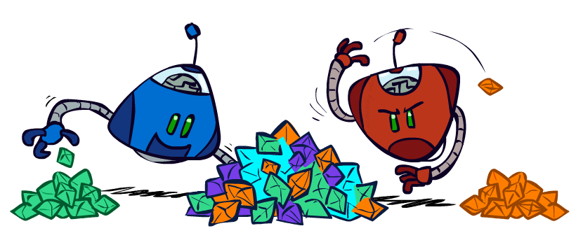
Zero-Sum Games
Zero-Sum Games
Agents have opposite utilities (values on outcomes)
Lets us think of a single value that one maximizes and the other minimizes
Adversarial, pure competition
General Games
Agents have independent utilities (values on outcomes)
Cooperation, indifference, competition, and more are all possible
More later on non-zero-sum games

Slide 10

Adversarial Search

Slide 11
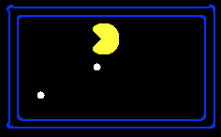
Single-Agent Trees
8
2
0
…
2
6
…
4
6

Slide 12
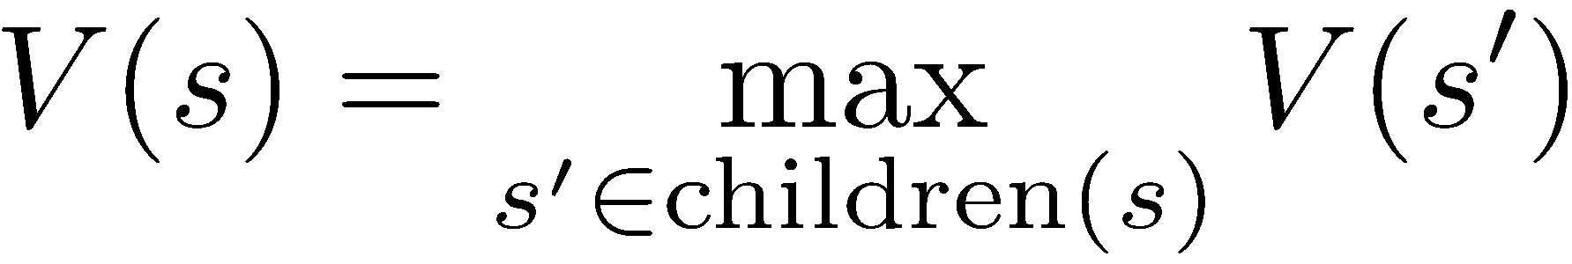
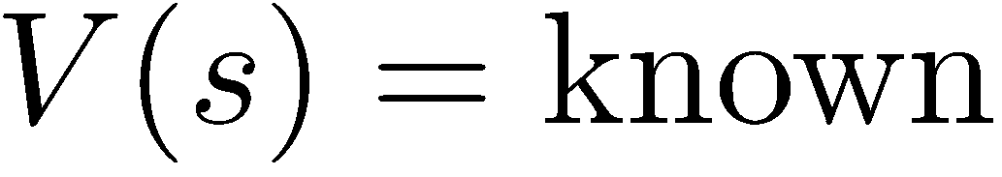
Value of a State
Value of a state: The best achievable outcome (utility) from that state
Non-Terminal States:
8
2
0
…
2
6
…
4
6
Terminal States:

Slide 13

Adversarial Game Trees
-20
-8
…
-18
-5
…
-10
+4
-20
+8

Slide 14
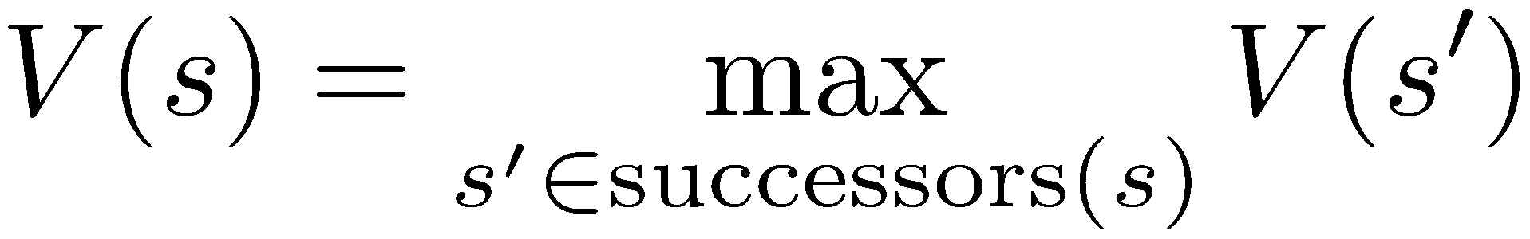
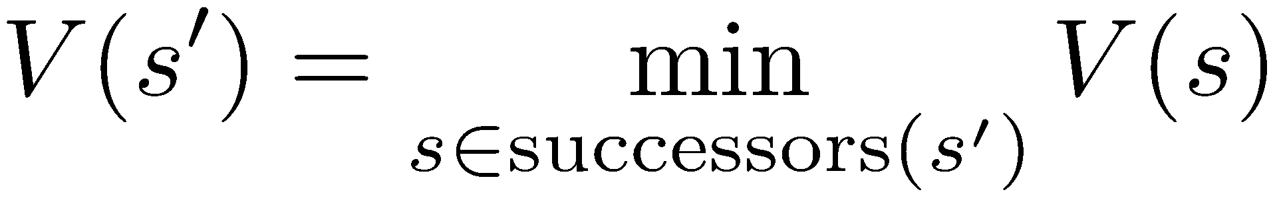
Minimax Values
States Under Agent’s Control:
States Under Opponent’s Control:
-8
-5
-10
+8
Terminal States:

Slide 15

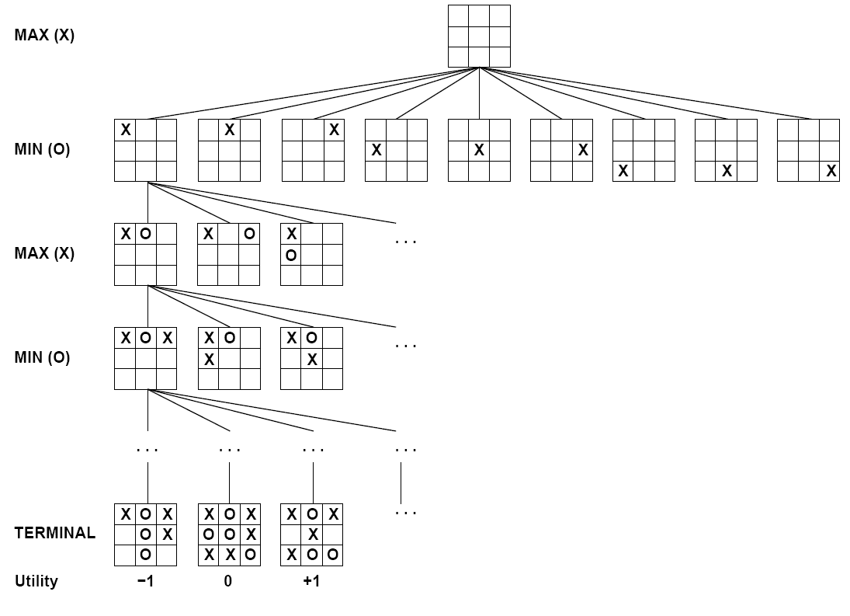

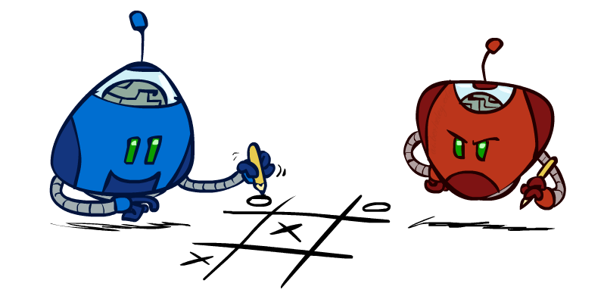
Tic-Tac-Toe Game Tree

Slide 16
Adversarial Search (Minimax)
Deterministic, zero-sum games:
Tic-tac-toe, chess, checkers
One player maximizes result
The other minimizes result
Minimax search:
A state-space search tree
Players alternate turns
Compute each node’s minimax value: the best achievable utility against a rational (optimal) adversary
Minimax values: computed recursively
5
max
2
5
min
8
2
5
6
Terminal values: part of the game

Slide 17
Minimax Implementation
def max-value(state):
initialize v = -∞
for each successor of state:
v = max(v, min-value(successor))
return v
def min-value(state):
initialize v = +∞
for each successor of state:
v = min(v, max-value(successor))
return v

Slide 18
Minimax Implementation (Dispatch)
def value(state):
if the state is a terminal state: return the state’s utility
if the next agent is MAX: return max-value(state)
if the next agent is MIN: return min-value(state)
def max-value(state):
initialize v = -∞
for each successor of state:
v = max(v, value(successor))
return v
def min-value(state):
initialize v = +∞
for each successor of state:
v = min(v, value(successor))
return v

Slide 19
Minimax Example
3
12
8
2
4
6
14
5
2

Slide 20
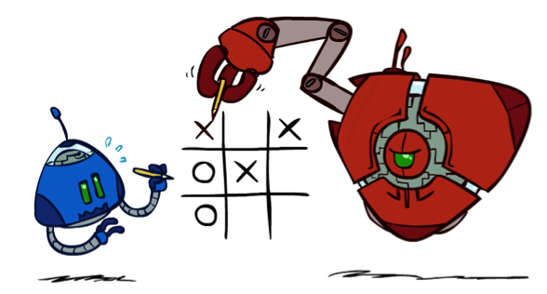
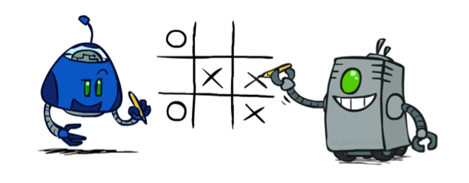
Minimax Properties
max
min
10
10
9
100
Optimal against a perfect player. Otherwise?

Slide 21
Video of Demo Min vs. Exp (Min)

Slide 22
Video of Demo Min vs. Exp (Exp)

Slide 23
Minimax Efficiency
How efficient is minimax?
Just like (exhaustive) DFS
Time: O(b^{m})
Space: O(bm)
Example: For chess, b ≈ 35, m ≈ 100
Exact solution is completely infeasible
But, do we need to explore the whole tree?

Slide 24

Resource Limits

Slide 25
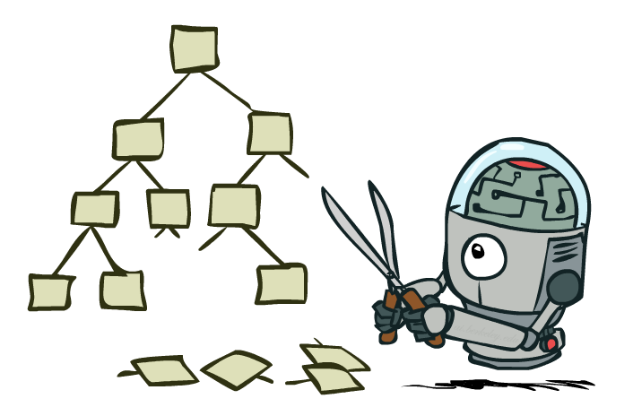
Game Tree Pruning

Slide 26
Minimax Example
3
12
8
2
4
6
14
5
2

Slide 27
Minimax Pruning
3
12
8
2
14
5
2

Slide 28
Alpha-Beta Pruning
General configuration (MIN version)
We’re computing the MIN-VALUE at some node n
We’re looping over n’s children
n’s estimate of the childrens’ min is dropping
Who cares about n’s value? MAX
Let a be the best value that MAX can get at any choice point along the current path from the root
If n becomes worse than a, MAX will avoid it, so we can stop considering n’s other children (it’s already bad enough that it won’t be played)
MAX version is symmetric
MAX
MIN
a
MAX
MIN
n

Slide 29
Alpha-Beta Implementation
α: MAX’s best option on path to root
β: MIN’s best option on path to root
def max-value(state, α, β):
initialize v = -∞
for each successor of state:
v = max(v, value(successor, α, β))
if v ≥ β return v
α = max(α, v)
return v
def min-value(state, α, β):
initialize v = +∞
for each successor of state:
v = min(v, value(successor, α, β))
if v ≤ α return v
β = min(β, v)
return v

Slide 30
Alpha-Beta Pruning Properties
This pruning has no effect on minimax value computed for the root!
Values of intermediate nodes might be wrong
Important: children of the root may have the wrong value
So the most naïve version won’t let you do action selection
Good child ordering improves effectiveness of pruning
With “perfect ordering”:
Time complexity drops to O(b^{m/2})
Doubles solvable depth!
Full search of, e.g. chess, is still hopeless…
This is a simple example of metareasoning (computing about what to compute)
max
min
10
10
0

Slide 31
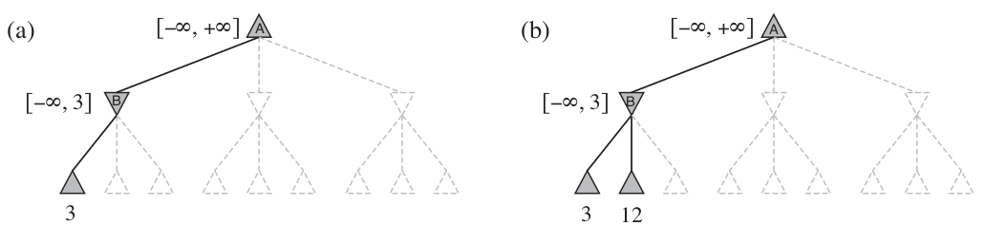
Alpha-Beta Pruning

Slide 32
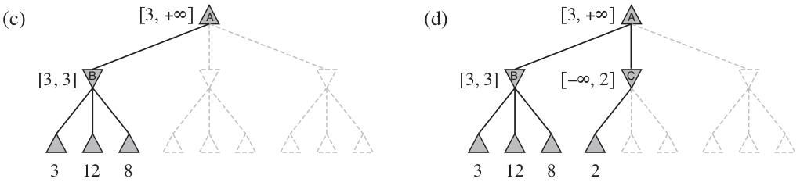
Alpha-Beta Pruning

Slide 33
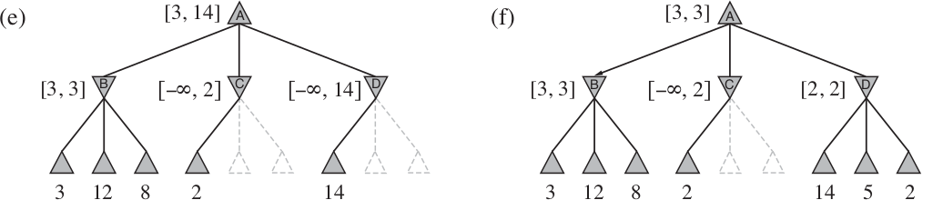
Alpha-Beta Pruning

Slide 34
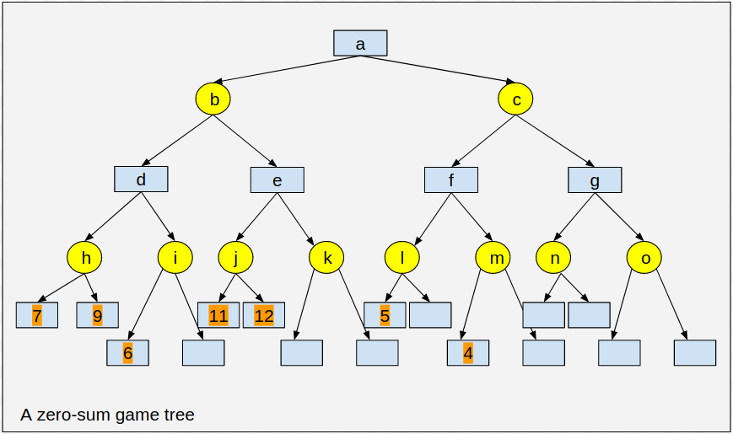
Alpha-Beta Pruning - Example (2)

Slide 35
Alpha-Beta Pruning - Example (2)
Starting a left first depth first traversal...

Slide 36
Alpha-Beta Pruning - Example (2)
7
Value of h, a min node is 7 , this just the minimum of 7 and 9

Slide 37
Alpha-Beta Pruning - Example (2)
7
Now the DFS progresses to i ---- i is a min node reached from d a max node.

Slide 38
Alpha-Beta Pruning - Example (2)
7
The left most node of i is 6. That is i value will be ≤ 6

Slide 39
Alpha-Beta Pruning - Example (2)
7
≤ 6
Should you continue search further from i now?
You can prune all other children of i now.

Slide 40
Alpha-Beta Pruning - Example (2)
≤ 7
7
7
≤ 6
The value of d is now 7. Also, While going up to b, a min node, its value is now less than or equal to 7.

Slide 41
Alpha-Beta Pruning - Example (2)
≤ 7
7
11
7
≤ 6
DFS proceeds e and then into j. j is a min-node and its value is 11

Slide 42
Alpha-Beta Pruning - Example (2)
≤ 7
7
≥ 11
11
7
≤ 6
DFS proceeds back into e. e is a max node and its value is at least 11

Slide 43
Alpha-Beta Pruning - Example (2)
≤ 7
7
≥ 11
11
7
≤6
Now, , should the search proceed into k? Why / why not?

Slide 44
Alpha-Beta Pruning - Example (2)
≤ 7
7
≥ 11
11
7
≤ 6
Now, should the search proceed into k? Nodes down k and other children of e are pruned.

Slide 45
Alpha-Beta Pruning - Example (2)
≥ 7
7
7
≥ 11
11
7
≤ 6
Now, ,Search from b is over with b taking value 7, a gets atleast 7 as its value.

Slide 46
Alpha-Beta Pruning - Example (2)
≥ 7
7
7
≥ 11
11
7
≤ 6
From a, search proceeds in DFS manner into l

Slide 47
Alpha-Beta Pruning - Example (2)
≥ 7
7
7
≥ 11
11
≤ 5
7
≤ 6
The first child of l has value of 5. So, l as a min node will have value less than or equal to 5. Should we proceed into other children of l?

Slide 48
Alpha-Beta Pruning - Example (2)
≥ 7
7
7
≥ 11
11
≤ 5
7
≤ 6
The first child of l has value of 5. So, l as a min node will have value less than or equal to 5. We need not proceed further, as its value will only the value of a down further.

Slide 49
Alpha-Beta Pruning - Example (2)
≥ 7
7
7
≥ 11
11
≤ 5
7
≤ 6
Search proceeds into m, hoping a better value at f

Slide 50
Alpha-Beta Pruning - Example (2)
≥ 7
7
7
≥ 11
≤ 5
≤ 4
11
7
≤ 6
m gets value ≤ 4. Search further into m’s children will not proceed

Slide 51
Alpha-Beta Pruning - Example (2)
≥ 7
7
≤ 5
7
≥ 11
≤ 5
≤ 4
11
7
≤ 6
The value of f is less than or equal to 5 now.

Slide 52
Alpha-Beta Pruning - Example (2)
≥ 7
7
≤ 5
≤ 5
7
≥ 11
≤ 5
≤ 4
11
7
≤ 6
Taking the search up, c capping its value at 5.
Will the search proceed further into g / its children?

Slide 53
Alpha-Beta Pruning - Example (2)
7
7
≤ 5
≤ 5
7
≥ 11
≤ 5
≤ 4
11
7
≤ 6
This results in fixing the value of a as 7, and a will take an action with value 7.

Slide 54
Alpha-Beta Pruning - Example (2)
7
7
≤ 5
≤ 5
7
≥ 11
≤ 5
≤ 4
11
7
≤ 6
Will the result change in writing any value in any of the unnumbered nodes? Try and answer.

Slide 55
Alpha-Beta Pruning - Example (2)
7
7
≤ 5
≤ 5
7
≥ 11
≤ 5
≤ 4
11
7
≤ 6
Will the result change in writing any value in any of the unnumbered nodes? NO. The answer that this pruning produces is same as that of Minimax Algorithm which we learned earlier.

Slide 56
Alpha-Beta Pruning - Example (2)
7
7
≤ 5
≤ 5
7
≥ 11
≤ 5
≤ 4
11
7
≤ 6
Will the result change in writing any value in any of the unnumbered nodes? NO. The answer that this pruning produces is same as that of Minimax Algorithm which we learned earlier.

Slide 57
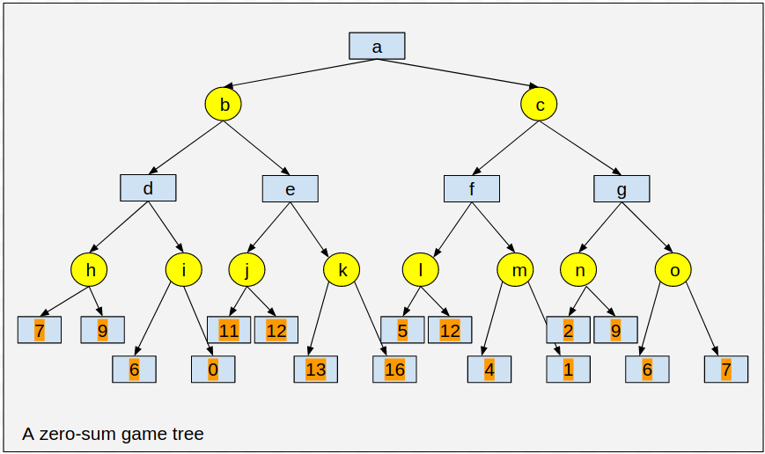
Alpha-Beta Pruning - Example (2)
Exercise: Try Minimax in this tree - [After the class ! or any tree in which the empty cells are filled with any random numbers]

Slide 58
Pruning by 𝛼
𝛼 is associated with max nodes, used to prune min nodes
It is highest current value of all the max ancestors
Any min node down this having value less than 𝛼 need not be explored further
Let's go back and check which nodes are pruned by this cut-off.

Slide 59
Alpha-Beta Pruning - Example (2)
7
7
≤ 5
≤ 5
7
≥ 11
≤ 5
≤ 4
11
7
≤ 7
In i, l, m and c, we pruned because their current value is the the best value of max ancestor nodes.

Slide 60
Pruning by 𝜷
𝜷 is associated with min nodes, used to prune max nodes
It is smallest current value of all the min ancestors
Any max node down this having value greater than 𝜷 need not be explored further
Let's go back and check which nodes are pruned by this cut-off.

Slide 61
Alpha-Beta Pruning - Example (2)
7
7
≤ 5
≤ 5
7
≥ 11
≤ 5
≤ 4
11
7
≤ 7
In l, m and c, we pruned because their current value is the the best value of max ancestor nodes.

Slide 62
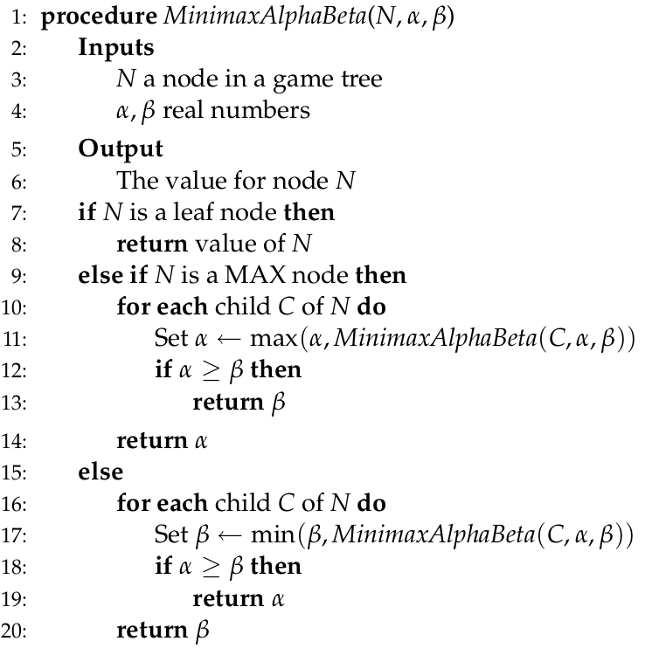
Alpha-Beta Pruning

Slide 63
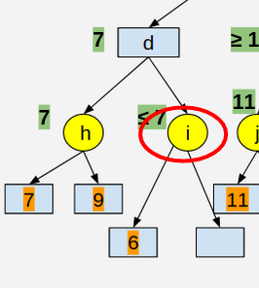
Ordering of Moves
Effectiveness is highly dependent on the order in which the states are examined
With optimal node ordering, alpha beta pruning needs to examine only O(b^{m/2} ) nodes
That is, O(sqrt(b)^{m} )
That is, alpha-beta pruning enables search to proceed further deeper, as much as twice as deeper as minimax algorithm
Even if the successors are examined in random order, experimentally shown to have an complexity improvement of O(b^{3m/4} ) nodes
Trying moves found to be best in the past improves further

Slide 64
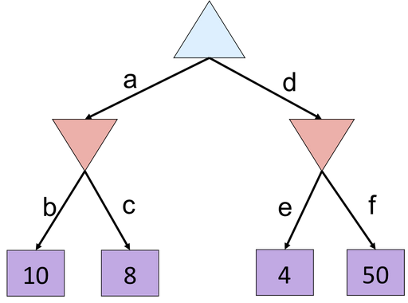
Alpha-Beta Quiz

Slide 65
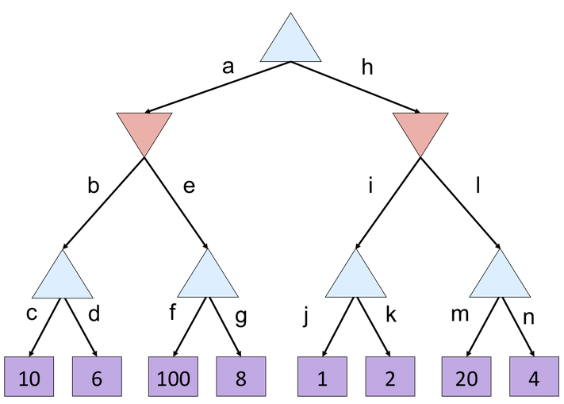
Alpha-Beta Quiz 2

Slide 66
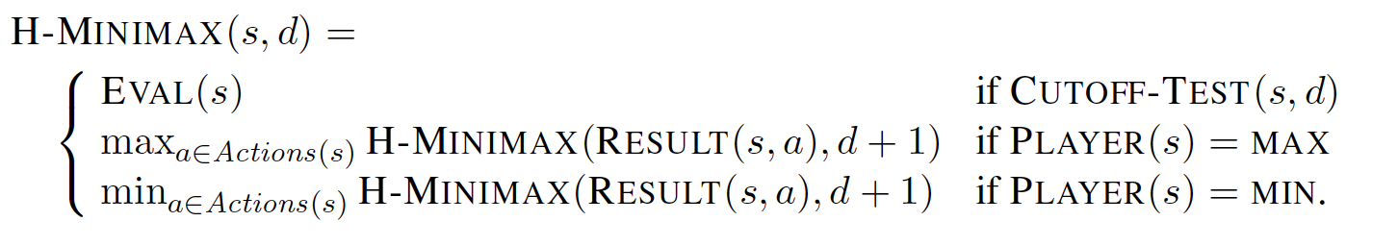
Further Optimizations
Claude Shannon suggested that
Programs can cut off search earlier and apply a heuristic Evaluation Function to states in the search measuring a probable utility value
Modifications to Minimax or Alpha-Beta
Replace the Utility function by a heuristic function EVAL, which estimates the position’s utility and
Replace the Terminal Test by a Cutoff Test that decides when to apply EVAL

Slide 67
Resource Limits

Slide 68
Resource Limits
Problem: In realistic games, cannot search to leaves!
Solution: Depth-limited search
Instead, search only to a limited depth in the tree
Replace terminal utilities with an evaluation function for non-terminal positions
Example:
Suppose we have 100 seconds, can explore 10K nodes / sec
So can check 1M nodes per move
α-β reaches about depth 8 – decent chess program
Guarantee of optimal play is gone
More plies makes a BIG difference
Use iterative deepening for an anytime algorithm
max
4
-2
4
min
-1
-2
4
9
?
?
?
?

Slide 69
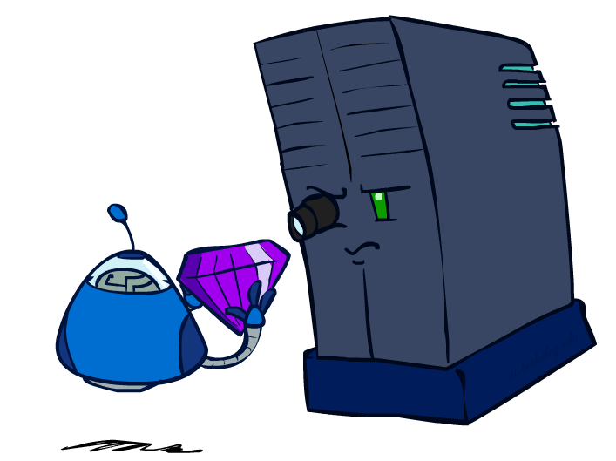
Evaluation Functions

Slide 70
Evaluation Functions
Evaluation functions score non-terminals in depth-limited search
Ideal function: returns the actual minimax value of the position
In practice: typically weighted linear sum of features:
e.g. f₁(s) = (num white queens – num black queens), etc.

Slide 71
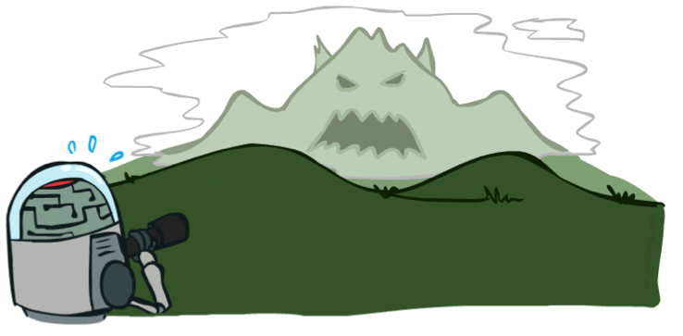

Depth Matters
Evaluation functions are always imperfect
The deeper in the tree the evaluation function is buried, the less the quality of the evaluation function matters
An important example of the tradeoff between complexity of features and complexity of computation

Slide 72
On Evaluation functions
Returns the estimate of expected utility of the game from a given position
For centuries, Chess experts had their heuristics in determining the value of a game state
Performance of game-playing program is highly dependent on the evaluation function
Some guidelines to build good evaluation functions
Evaluation function should order the terminal states in the same way as true utility function
Computation must not take too long
For nonterminal nodes, the evaluation function results should be strongly correlated with the actual chances of winning

Slide 73
Designing Evaluation functions
General Approach 1: Calculating various features of a state
eg., In Chess, we would have features like number of white pawns, black pawns, white queens, black queens and so on.
The features together define various categories of states
The states in each category would have the same feature value
The evaluation function doesn’t look at the exact state, however, calculates the chances of winning by the proportion of times that category has resulted in a win/loss/draw.
E.g., for the category two-pawns vs one-pawn lead to win in 72% of all games, lead to loss in 20% and draw in 8%.
Then the expected evaluation = (0.72 * 1) + (0.2 * 0) + (0.08 * 0.5) = 0.76

Slide 74
Designing Evaluation functions
General Approach 2: Compute separate numerical contributions from each feature and them combine them to find the total value
E.g., Each pawn is worth 1, a knight/bishop is worth 3, ”good pawn structure” is worth 0.5, “king safety” is worth 1
Simply add them up to get the evaluation score
Or, add them using a weighted linear function

Slide 75
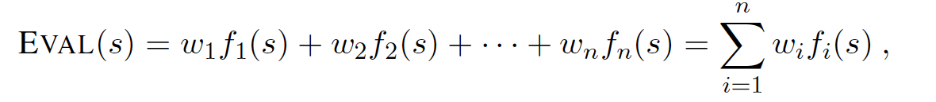
Designing Evaluation functions
General Approach 2: Compute separate numerical contributions from each feature and them combine them to find the total value
E.g., Each pawn is worth 1, a knight/bishop is worth 3, ”good pawn structure” is worth 0.5, “king safety” is worth 1
Simply add them up to get the evaluation score
Or, add them using a weighted linear function

Slide 76
Synergies between Evaluation Function and Alpha-Beta?
Alpha-Beta: amount of pruning depends on expansion ordering
Evaluation function can provide guidance to expand most promising nodes first (which later makes it more likely there is already a good alternative on the path to the root)
(somewhat similar to role of A* heuristic)
Alpha-Beta: (similar for roles of min-max swapped)
Value at a min-node will only keep going down
Once value of min-node lower than better option for max along path to root, can prune
Hence: IF evaluation function provides upper-bound on value at min-node, and upper-bound already lower than better option for max along path to root THEN can prune

Slide 77
Thank you for your Attention
Any more queries

